Slide 1
Welcome to class!
Please pick up your Lancer Literacy Journal and have it ready before the bell rings.

Slide 2
Lancer Literacy Synthesis Summary

Slide 3
Part A

Slide 4
Vincent van Gogh’s The Starry Night (1889)

Slide 5
In your Lancer Literacy Journals:
Study the painting. What are your eyes drawn to first?
Now consider this quote from van Gogh to his brother Theo:
“Looking at the stars always makes me dream. ‘Why,’ I ask myself, ‘shouldn’t the shining dots of the sky be as accessible as the black dots on the map of France?’”
In what ways does van Gogh make the stars accessible? In what ways do the stars contrast with the village?

Slide 6
Part B

Slide 7
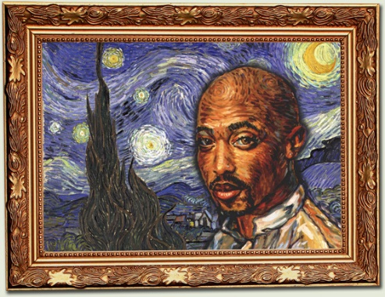
Tupac Shakur -
Image featured in the posthumous CD album cover R U Still Down? Remember Me

Slide 8
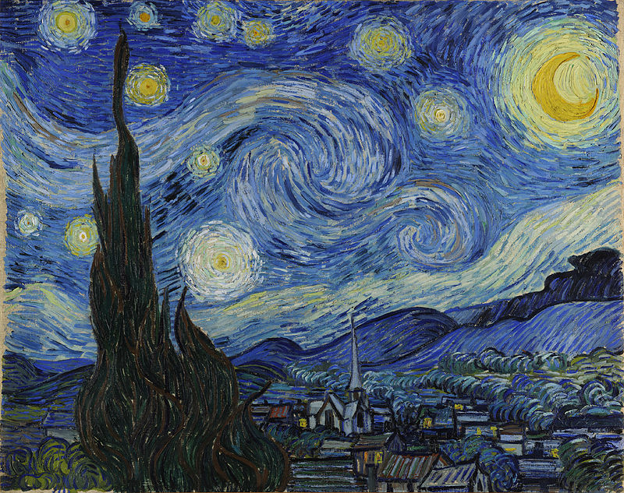
Tupac Shakur’s “The Starry Night”
A creative heart, obsessed with satisfying this dormant and uncaring society you have given them the stars at night and you have given them Bountiful Bouquets of Sunflowers but 4 u there is only contempt and though you pour yourself into that fame and present it so proudly this world could not accept your masterpieces from the heart. So on that starry night you gave to us and you took away from us the one thing we never acknowledged your life.

Slide 9
In your Lancer Literacy Journals:
Write your understanding of the poem.
What effect does it have on you as a reader? What elements of figurative language can you find in the poem?

Slide 10
Part C

Slide 11
“The Starry Night” by Anne Sexton
Read the poem.
Epigraph:
a short quotation or saying at the beginning of a book or chapter, intended to suggest its theme

Slide 12
Anne Sexton’s “The Starry Night” (1961)
That does not keep me from having a terrible need of - shall I say the word - religion. Then I go out at night to paint the stars. - Vincent Van Gogh in a letter to his brother
The town does not exist except where one black haired tree slips up like a drowned woman into the hot sky. The town is silent. The night boils with eleven stars. Oh starry starry night! This is how I want to die.
It moves. They are all alive. Even the moon bulges in its orange irons to push children, like a god, from its eye. The old unseen serpent swallows up the stars. Oh starry starry night! This is how I want to die:
into the rushing beast of the night, sucked up by that great dragon, to split from my life with no flag, no belly, no cry.

Slide 13
In your Lancer Literacy Journals:
Write your understanding of the poem.
What effect does it have on you as a reader? What elements of figurative language can you find in the poem?

Slide 14
Part D

Slide 15
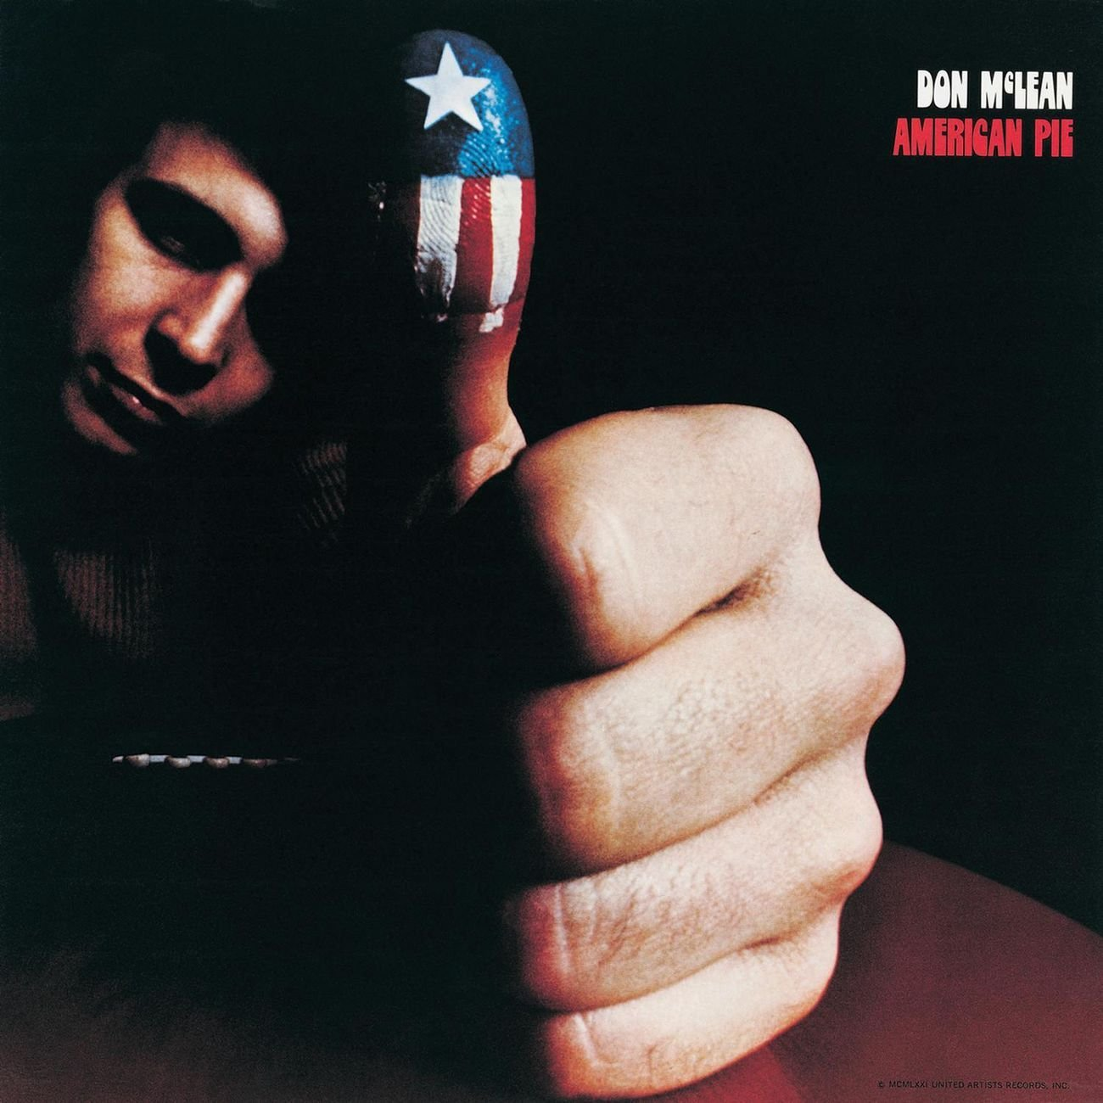
Don McLean’s “Vincent” (1971)
Link to video here

Slide 16
In your Lancer Literacy Journals:
Write your understanding of the lyrics.
What effect does it have on you as a listener? What elements of figurative language can you find in the lyrics?

Slide 17
Now…
Fill out the Lancer Literacy Synthesis Summary Chart using van Gogh’s painting The Starry Night and Anne Sexton’s poem The Starry Night.

